Slide 1
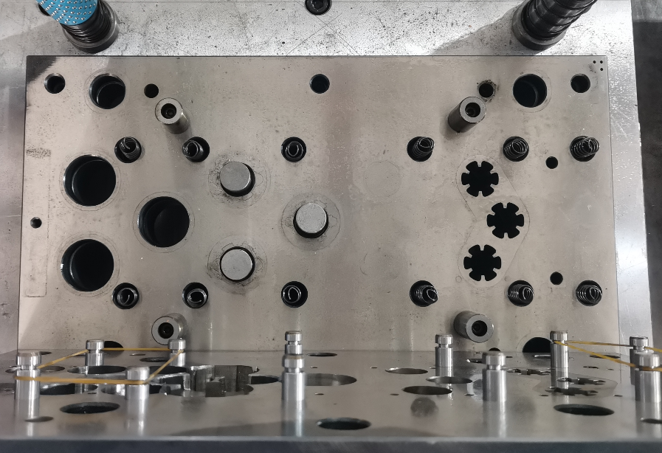
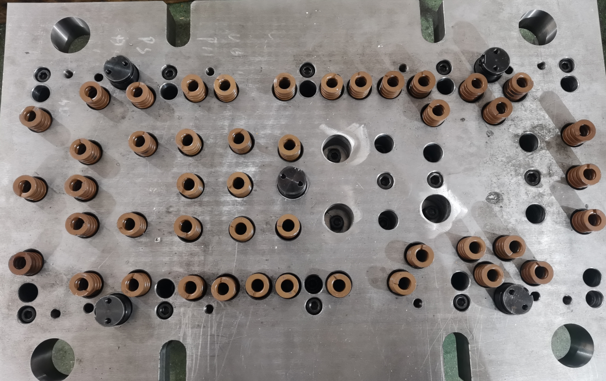
Die Management Process
1
Die routine inspection
NO | Check List | File Attaments
1 | Establish a daily mold inspection based on set standards, visually inspect the condition of casting molds, and document findings on a mold maintenance record sheet. When the issues are detected during visual inspections, the mold supervisor is to be notified. Upon confirmation of the tool's condition, the mold is maintained according to daily inspection standards.
2 | Establish a mold history card and a mold life management table. To prevent mold loss: Establish a mold assembly checklist to avoid missing or leftover items.

Slide 2
Die Management Process
2
Die routine inspection
NO | Check List | File Attaments
1 | Establish regular mold inspection according to mold inspection standards, visually check the status of the casting model and record it on the mold maintenance record sheet. Establish a mold history card and a mold life management table.
2 | Cumulative count management: The mold is regularly checked every 10K. Regular maintenance every 50K. Establish a routine mold maintenance record card
3 | Prevent mold assembly from missing. To prevent mold loss: Establish a mold assembly checklist to prevent missing or remaining items.

Slide 3
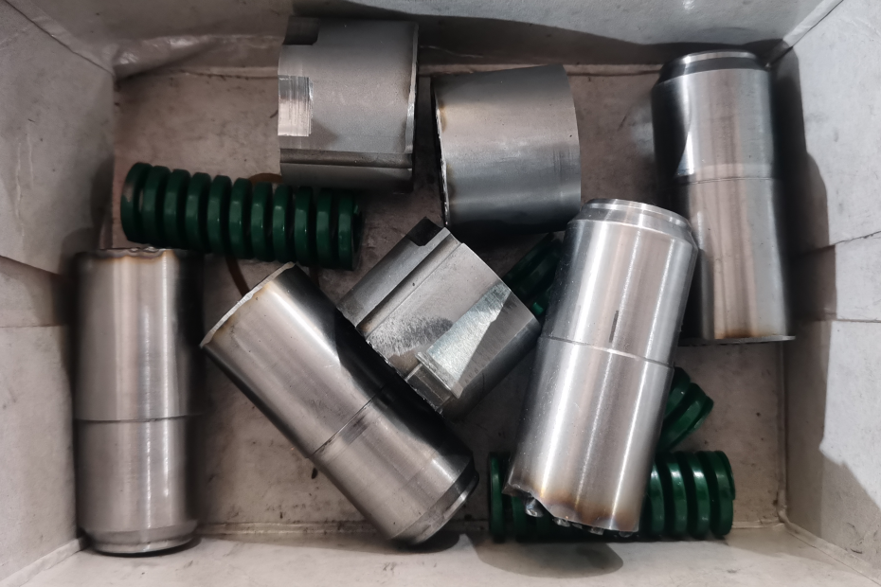
Die Management Process
3
Die Conservation Repair
NO | Check List | File Attaments
1 | Establish a mold maintenance plan.
2 | Set up parts list and replacement parts record.

Slide 4
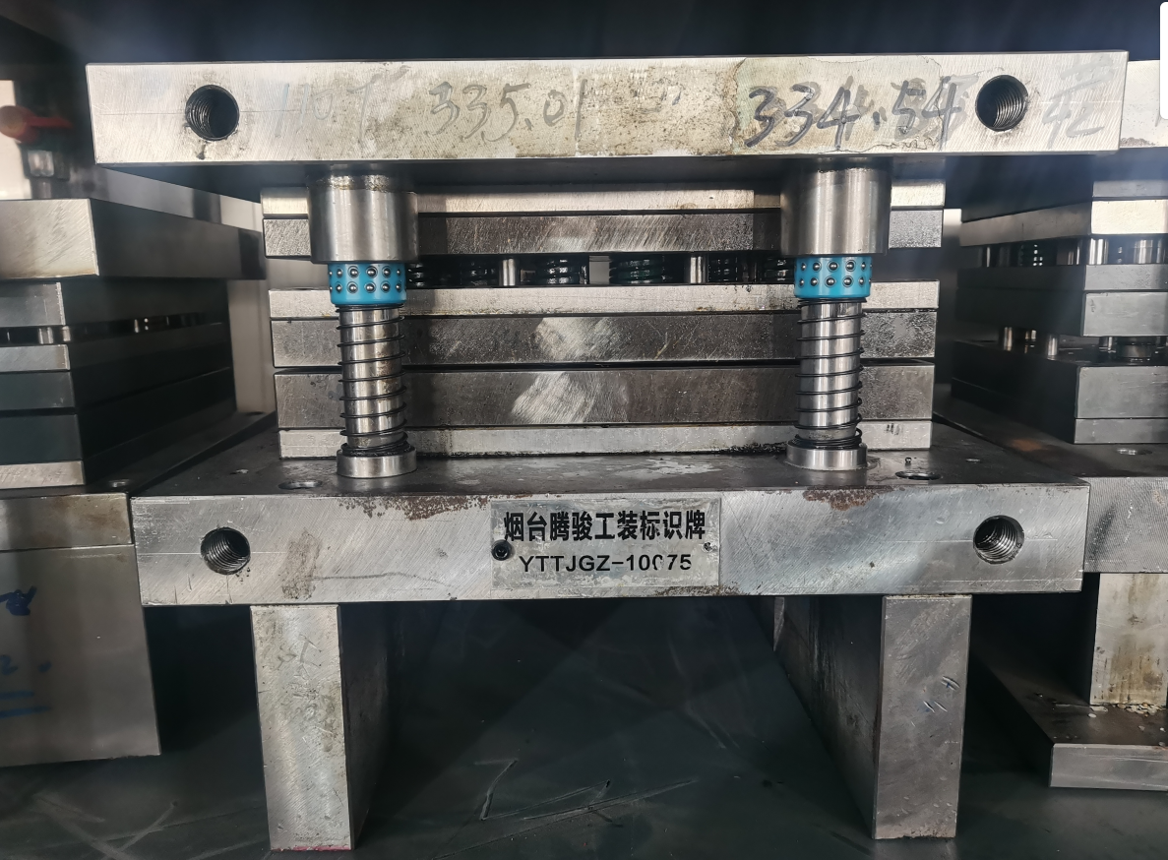
Die Management Process
4
Die Lifecycle Management
NO | Check List | File Attaments
1 | Manage the storage status of molds, repair history and keep records.
2 | When molds are not in use, they are stored on the mold rack for management and maintenance. Set up a ledger for mold management.
3 | Mold profile attached with a name plate number. Confirm mold custody, status quo of the management by using the nameplate number, maintenance/inspection by same nameplate number management status in the confirmation record card.
4 | Mold cleaning: The current mold maintenance has a clean action. Plan to establish mold cleaning stations and management standards within six months.
5 | Establish a management ledger for abandoned molds. Implement storage treatment for waste molds.

